Slide 1
Predictive Maintenance of Industrial Machinery using IBM AutoAI
IBM AICTE PROJECT
Presented By: VISHAL NEGI
COLLEGE : MAHARAJA SURAJMAL INSTITUTE OF TECHHNOLOGY
DEPARTMENT: CSE

Slide 2
OUTLINE
Problem Statement
Proposed System/Solution
System Development Approach
Algorithm & Deployment
Result
Conclusion
Future Scope
References

Slide 3
Problem Statement
In industries, unexpected equipment failures lead to costly downtime, repair expenses, and safety hazards. Predictive maintenance aims to forecast failures before they occur, allowing proactive servicing. This project develops a machine learning model to classify the type of machinery failure based on sensor readings, enabling maintenance teams to take timely action.

Slide 4
Proposed Solution
Use IBM AutoAI to train a multi-class classification model that predicts the failure type.
Train the model on the Predictive Maintenance Dataset from Kaggle.
AutoAI automates: Data preprocessing
Feature Engineering
Model Selection and Tuning
Deploy the best pipeline as a REST API on IBM Cloud for industrial use.

Slide 5
System Approach
System Requirements:
IBM Cloud Lite account
AutoAI service
Predictive Maintenance Dataset
Steps:
Evaluate best model & deploy to cloud.
Upload dataset to IBM Cloud.
Launch AutoAI experiment.
Select multi-class classification with Failure Type as target.
AutoAI builds and tests multiple pipelines automatically.

Slide 6
Algorithm & Deployment
Best Algorithm: Batched Tree Ensemble Classifier (Snap Random Forest Classifier)
Accuracy (Holdout): 99.7%
Deployment: Deployed as REST API on IBM Cloud for real-time predictions.
Enhancements Used: HPO-1, HPO-2, Feature Engineering

Slide 7
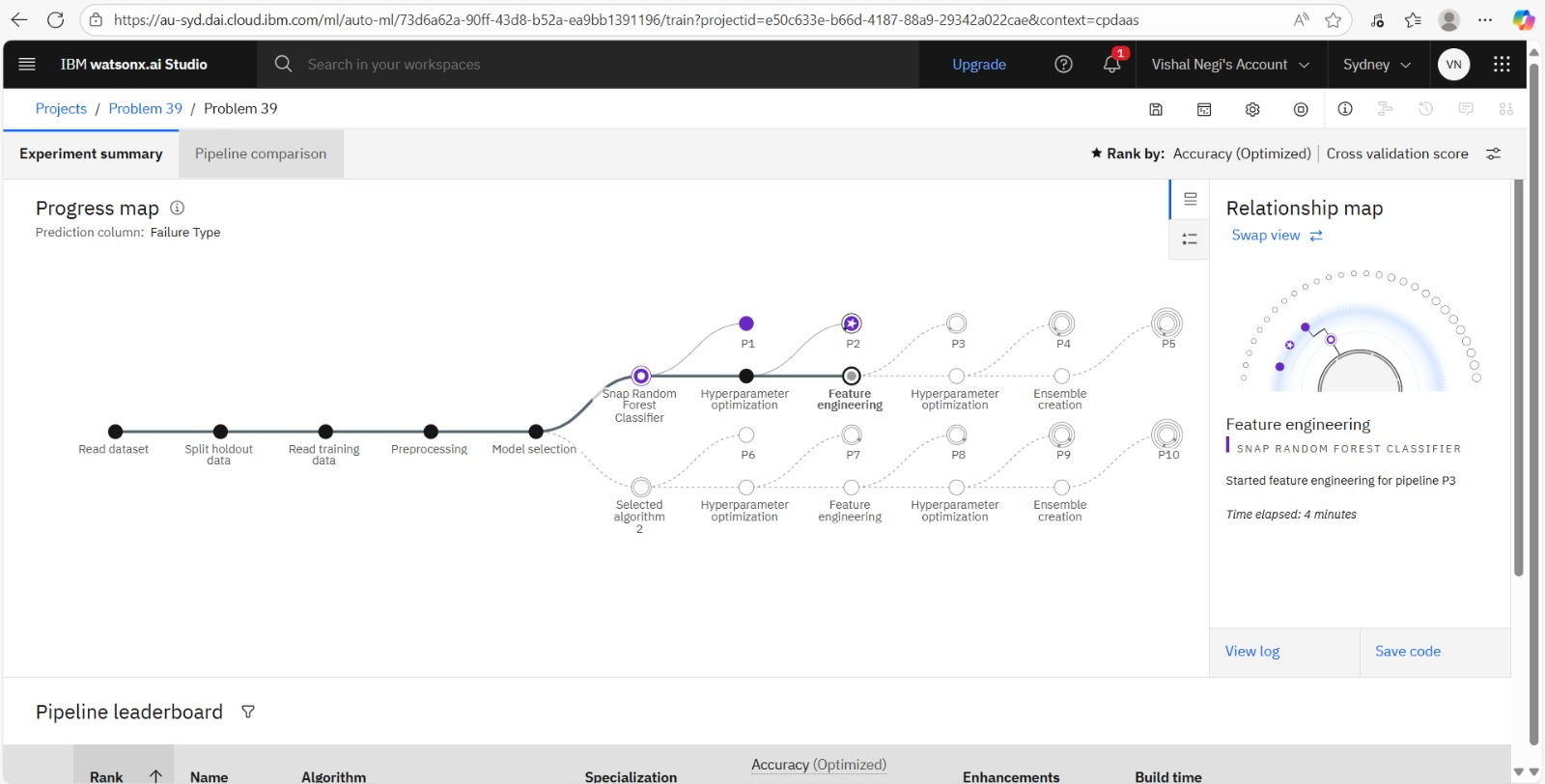
Result
MODEL TRAINING :

Slide 8
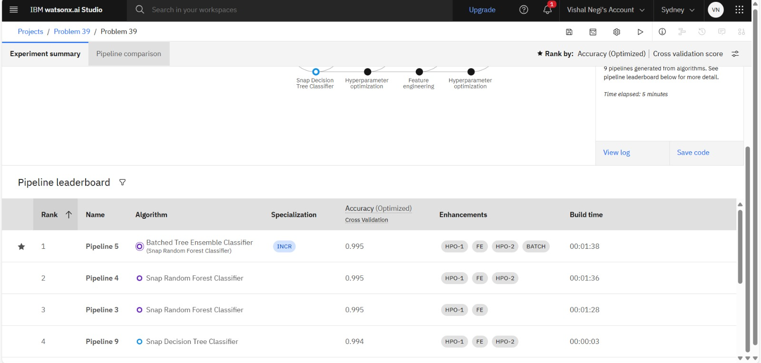
Result
BEST MODEL :

Slide 9
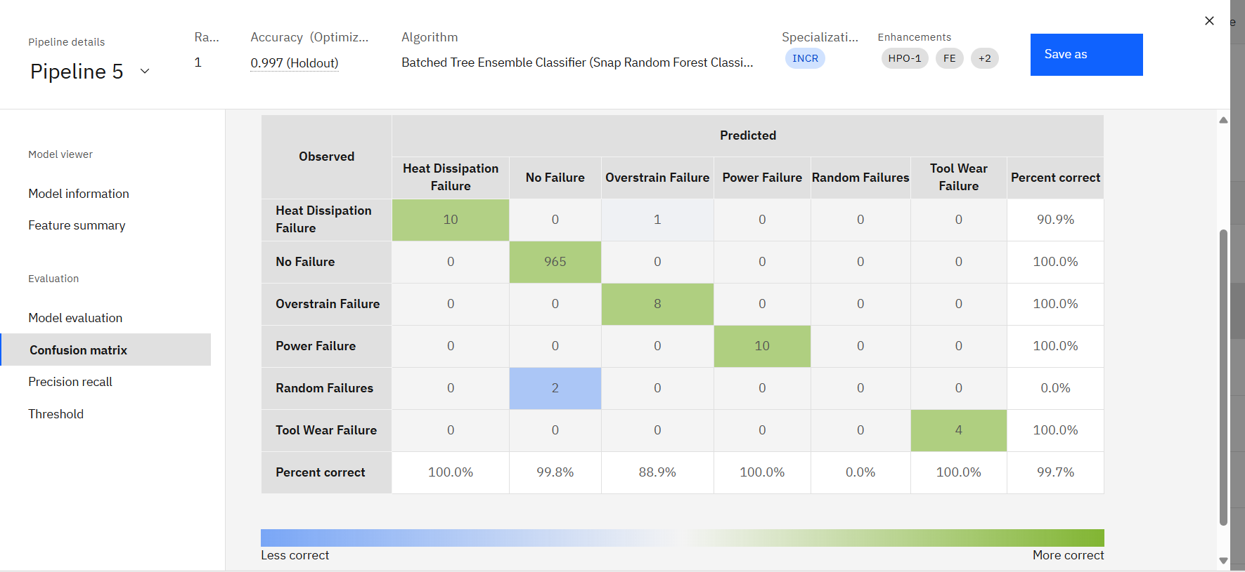
Result
CONFUSION MATRIX :

Slide 10
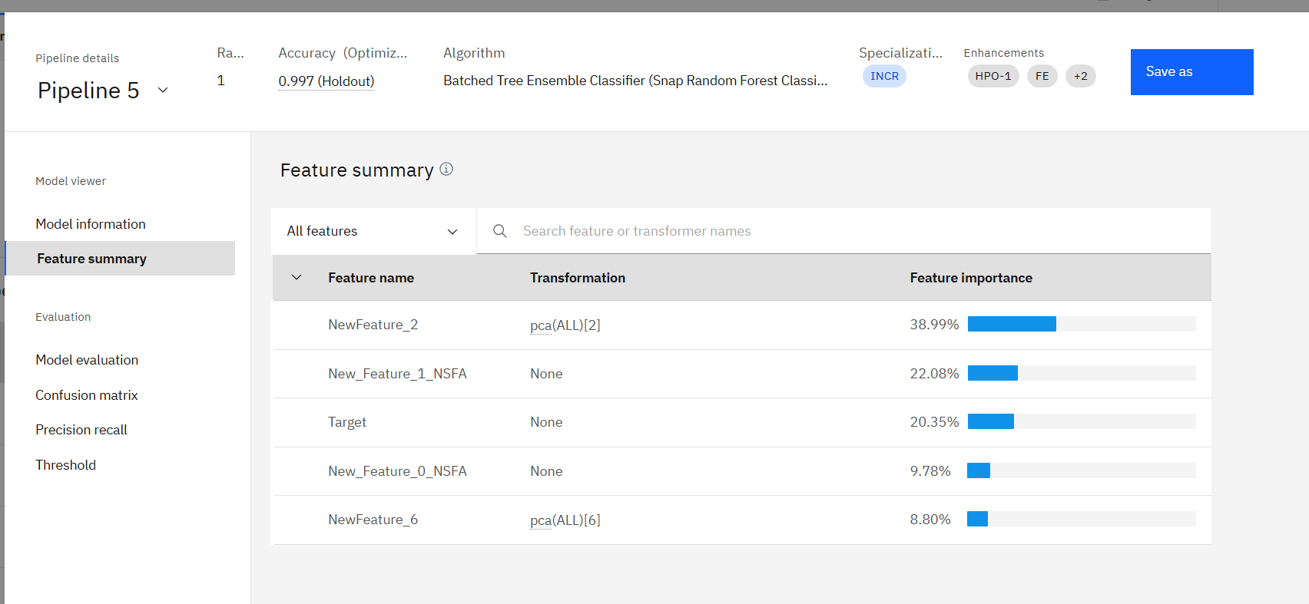
Result
FEATURE IMPORTANCE :

Slide 11
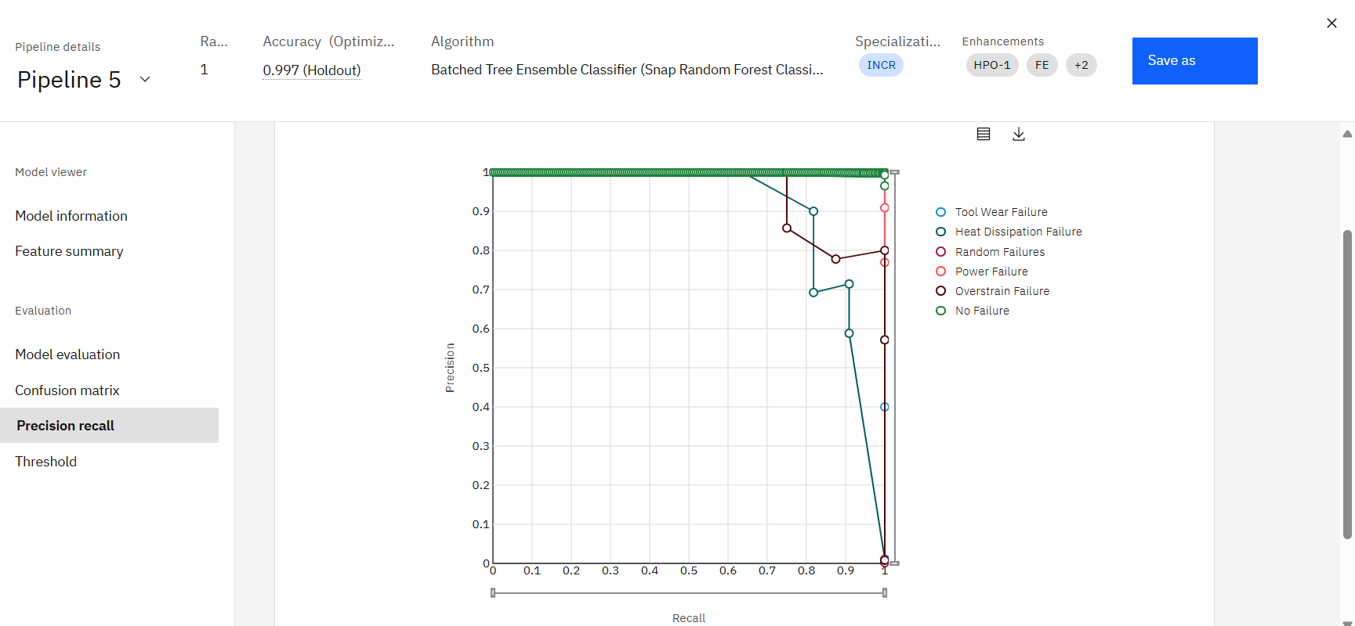
Result
HIGH PRECISION AND RECALL:

Slide 12
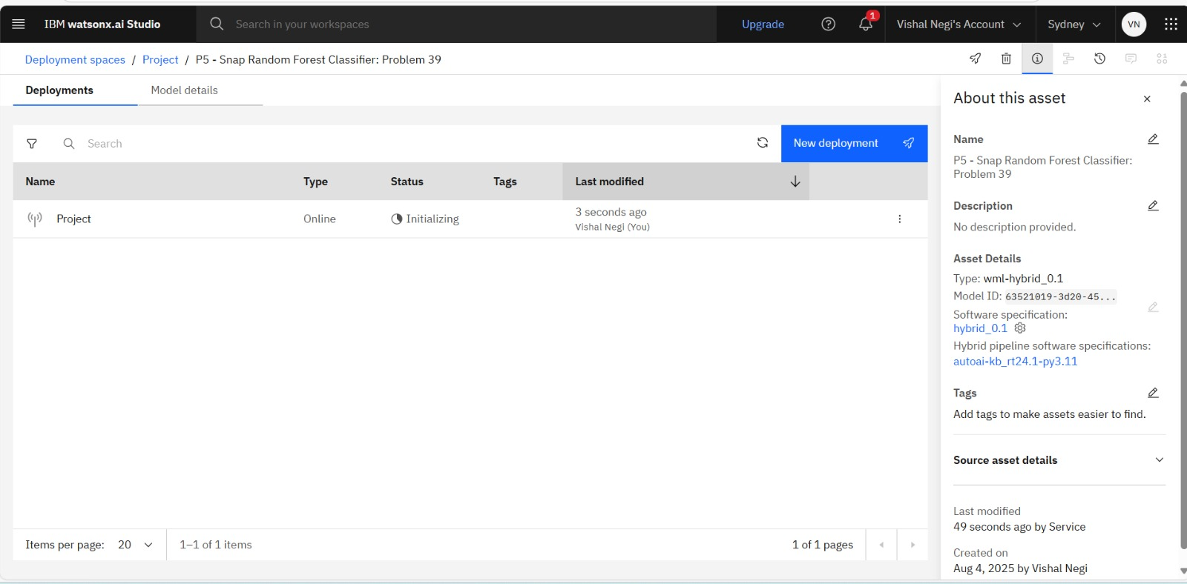
Result
DEPLOYMENT :

Slide 13
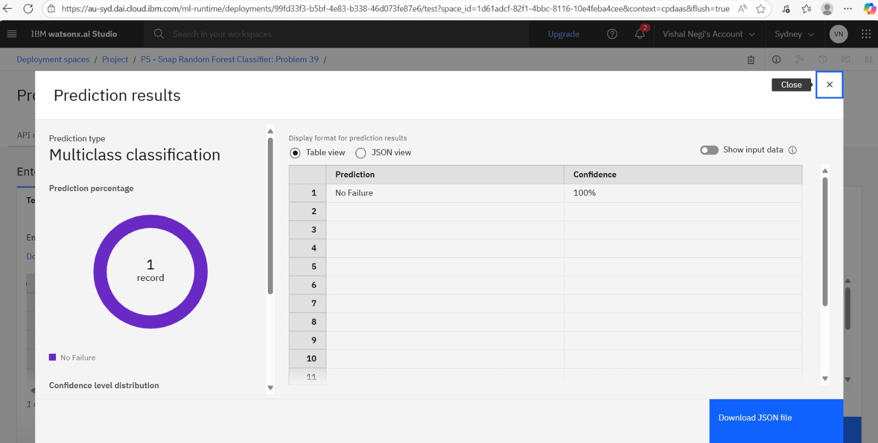
Result
Model testing :

Slide 14
Conclusion
AutoAI model achieved 99.7% accuracy in predicting machine failures.
Most failure types were perfectly classified.
Shows strong potential for industrial predictive maintenance applications.

Slide 15
Future scope
Add more data for rare failure types.
Integrate with real-time IoT sensor data.
Use Explainable AI for maintenance recommendations.

Slide 16
References
Kaggle Dataset: Predictive Maintenance Dataset
IBM AutoAI Documentation
Industry articles on predictive maintenance

Slide 17
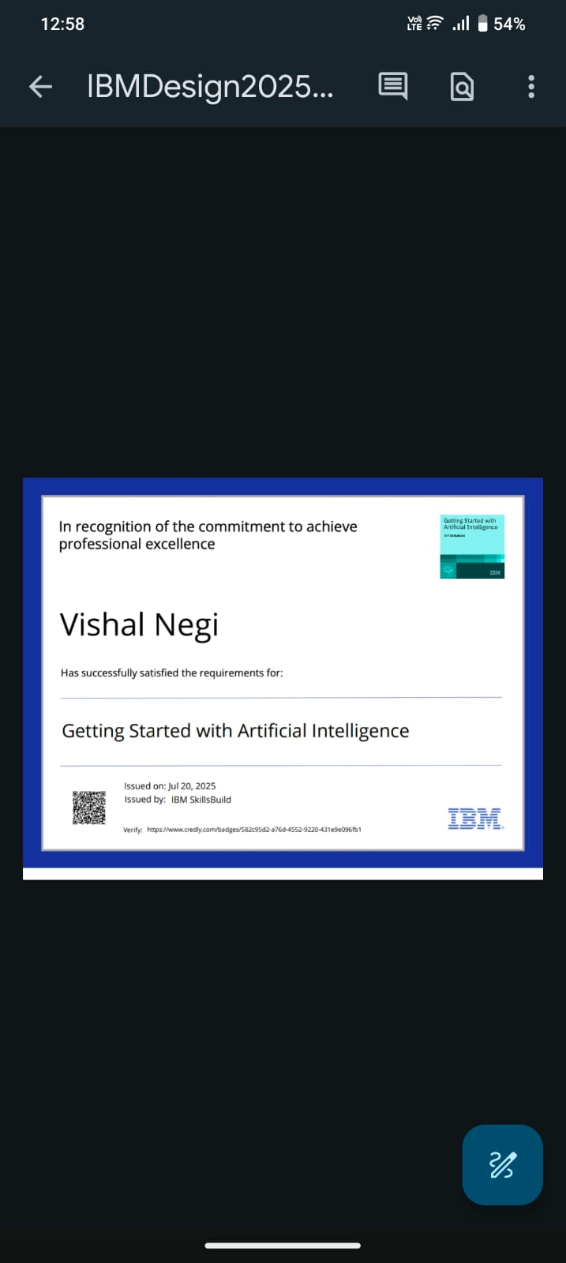
IBM Certifications
Screenshot/ credly certificate( getting started with AI)
Screenshot/ credly certificate( getting started with AI)

Slide 18
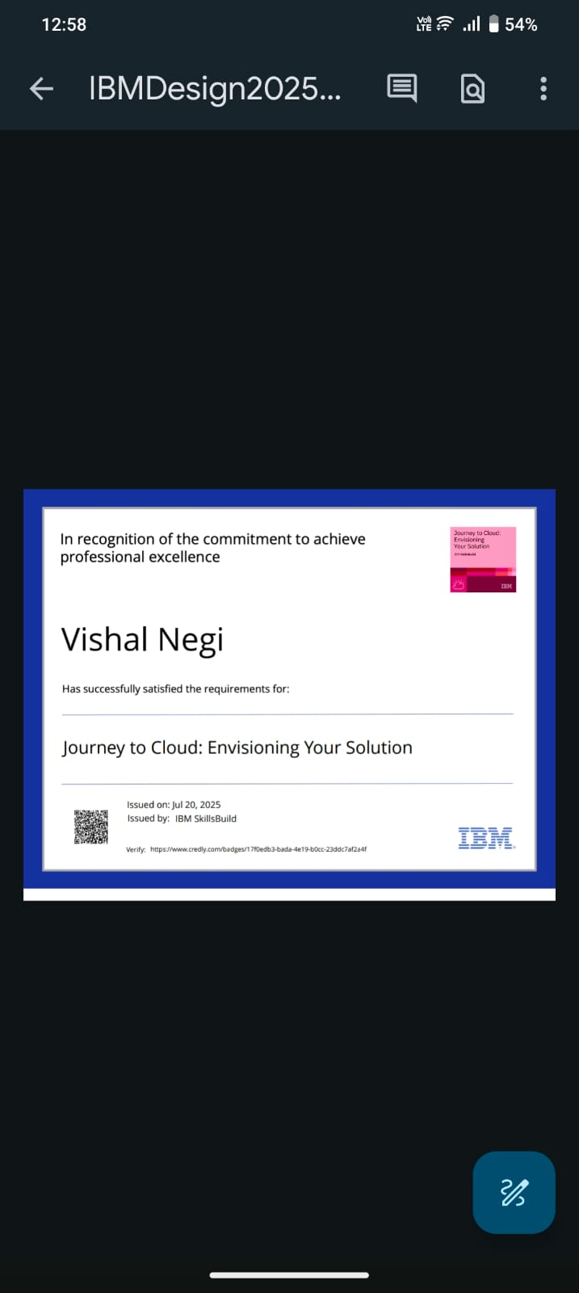
IBM Certifications
Screenshot/ credly certificate( Journey to Cloud)
Screenshot/ credly certificate( Journey to Cloud)

Slide 19
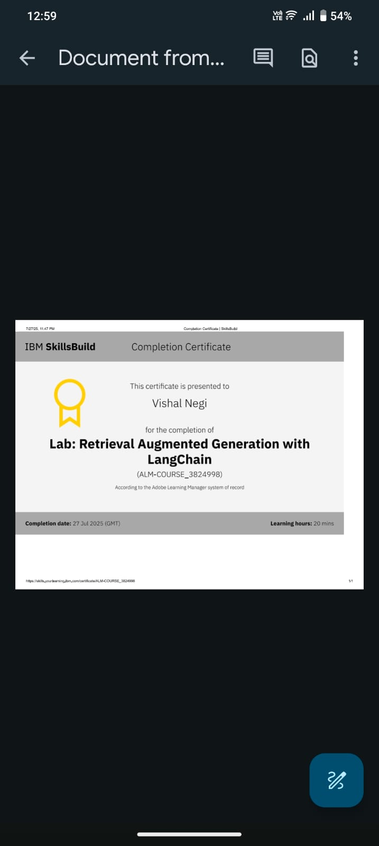
IBM Certifications
Screenshot/ credly certificate(RAG LAB)

Slide 20
Github Link : VishalNegi21/IBM_internship

Slide 21
THANK YOU

